Slide 1

JavaScript

Slide 2
Agenda
Module 1: JavaScript Fundamentals Module 2: JavaScript Essentials
Module 3: JavaScript Functions
Module 4: JavaScript Multiple Values Module 5: Event and Event Handler
Module 6: DOM and Form Manipulation Module 7: Advanced JavaScript
S/W Requirements
IDE : Visual Studio
Browser: Google Chrome

Slide 3
Module 1: JavaScript Fundamentals
2

Slide 4
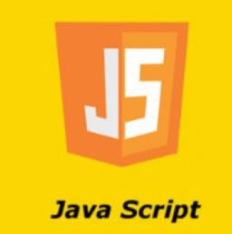
What is JavaScript
JavaScript is a cross-platform, object-oriented scripting language used to make webpages interactive.
When a JavaScript is placed inside a web page, the browser loads the page & built-in interpreter reads the JavaScript code & execute
JavaScript is case sensitive and dynamic typing, loosely typed
i.e. variable data types are not declared
JavaScript is used in Web pages for
Validating data.
Putting dynamic content into an HTML page.
To make them interactive

Slide 5
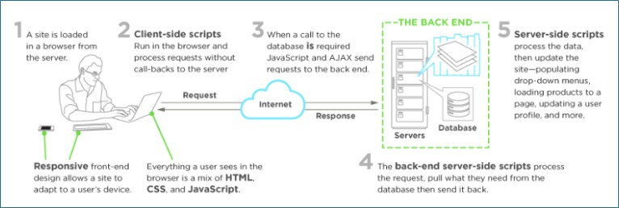
Client and Server-side scripting

Slide 6
Let us start with JS
5

Slide 7
Where to write java script
Inline Scripting : <script></script>
External Scripting: <script src=“myjs.js”> </script>
Html Page
<head></head>
<script>
// java script code
</script>
<body></body>

Slide 8
Module 2: Java Script Essentials
7

Slide 9
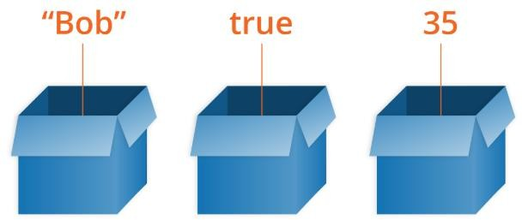
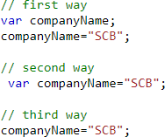
Variable and variable declarations
A variable is a container for a value, like a number we might use in a sum, or a string that we might use as part of a sentence.
Declares a variable, optionally initializing it to a value.

Slide 10
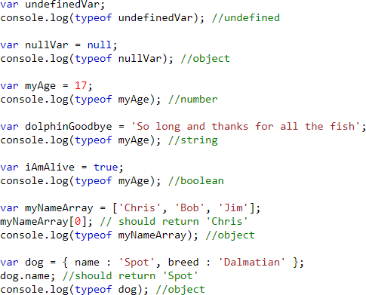
Different ways to declare a variable
undefined
null
number
string
boolean
array
object

Slide 11
Manipulating Strings in JavaScript
Create a string by enclosing a sequence of characters in quotes.
1.Single Quotes (' ')
let sone = 'Hello All';
//output: Hello All
2.Double Quotes (" ")
3.Backticks (‘ ‘)
let stwo = "Welcome to the Bootcamp";
//output: Welcome to the Bootcamp
let text = `It's secured "website"`;
//output: It's secured " website"

Slide 12
String Methods
JavaScript provides several methods that you can use to manipulate strings. Let's look at some of the most used methods:
Methods | Description
String.charAt() | Returns a string representing the character at the given index.
String.charCodeAt() | Returns a number representing the UTF-16 code unit value of the character at the given index.
String.concat() | Returns a new string containing the concatenation of the given strings.
String.endsWith() | Returns true if the string ends with the given string, otherwise false.
String.includes() | Returns true if the string contains the given string, otherwise false.
String.indexOf() | Returns the index within the string of the first occurrence of the specified value, or -1 if not found.
String.startsWith() | Returns true if the string starts with the given string, otherwise false.
String.toLowerCase() | Returns a new string with all the uppercase characters converted to lowercase.
String.toUpperCase() | Returns a new string with all the lowercase characters converted to uppercase.
String.toString() | Returns the string representation of the specified object.

Slide 13
String Methods cont..
Methods | Description
String.lastIndexOf() | Returns the index within the string of the last occurrence of the specified value, or -1 if not found.
String.match() | Returns a list of matches of a regular expression against a string.
String.matchAll() | Returns a list of matches of a regular expression against a string.
String.padEnd() | Returns a new string with some content padded to the end of the string.
String.repeat() | Returns a new string which contains the specified number of copies of the string.
String.replace() | Returns a new string with some or all matches of a regular expression replaced by a replacement string.
String.search() | Returns the index within the string of the first occurrence of the specified value, or -1 if not found
String.substring() | Returns a new string containing the characters of the string from the given index to the end of the string.
String.trim() | Returns a new string with the leading and trailing whitespace removed.
String.trimEnd() | Returns a new string with the trailing whitespace removed.
String.trimStart() | Returns a new string with the leading whitespace removed.

Slide 14
Understanding JavaScript Numbers
JavaScript Numbers are primitive data types.
There are two types of JavaScript numbers: integer and floating-point. An integer is a whole number, whereas a floating-point number includes a decimal point. For example, 5 is an integer, and 3.14 is a floating-point number.
JavaScript numbers are always stored in double-precision 64-bit binary format IEEE 754.
Property | Description
MAX_VALUE | The largest number possible in JavaScript
MIN_VALUE | The smallest number possible in JavaScript
POSITIVE_INFINITY | Infinity (returned on overflow)
NEGATIVE_INFINITY | Negative infinity (returned on overflow)
NaN | A "Not-a-Number" value
EPSILON | The difference between 1 and the smallest number > 1.

Slide 15
Understanding JavaScript Numbers Methods
These number methods can be used on all JavaScript numbers:
Method | Description
toString() | Returns a number as a string
toExponential() | Returns a number written in exponential notation
toFixed() | Returns a number written with a number of decimals
toPrecision() | Returns a number written with a specified length
valueOf() | Returns a number as a number
In addition to the above methods, JavaScript provides various math methods such as Math.round(), Math.ceil(), Math.floor(), Math.abs(), and many more that can be used to perform mathematical operations on numbers.

Slide 16
JavaScript Type Conversion
While JavaScript provides numerous ways to convert data from one type to another there are two most common data conversions:
Converting Number to Strings
Converting a String to Numbers

Slide 17
Module 3: Functions
16

Slide 18


What is a Function
Function Declaration
Fundamental building blocks in JavaScript.
A set of statements that performs a task or calculates a value.
To use a function, you must define it somewhere in the
scope from which you wish to call it.
Function can be created in many ways: Function Declaration
Function Expression
Function Expression

Slide 19

Function Declaration
A function declaration consists of the function keyword, followed by:
The name of the function.
A list of parameters to the function, enclosed in parentheses
and separated by commas.
The JavaScript statements that define the function, enclosed in curly brackets, { }.

Slide 20

Function Expression
Anonymous Function expression
Named Function Expression

Slide 21
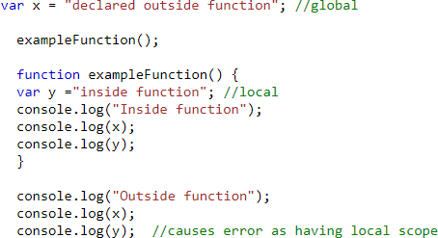
Scoping
When you declare a variable outside of any function, it is called a global variable, because it is available to any other code in the current document.
When you declare a variable within a function, it is called a local variable, because it is available only
within that function.

Slide 22
Hands on variable and functions
Create a function which displays the Fibonacci series for 10 numbers: 0,1,1,2,3,5,8,13,21,25
Create a function which display the table of 8.

Slide 23
Module 4: JavaScript Multiple Values:
Array, String and Objects
22

Slide 24

Array
An array can hold many values under a single variable name, and you can access the values by referring to an index number.
Array can consist homogenous as well as
heterogenous elements.
Iteration of the array can be done using loops.
John | Doe | 46
0
1
2

Slide 25
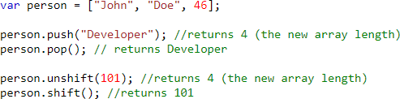
Array Methods
Below are the methods to add or delete the elements from the array (starting , ending or from some index number also)
add at the start: arr.unshift(ele)
add at the end: arr.push(ele)
John | Doe | 46
0
1
2
remove from the start arr.shift()
remove from the end arr.pop()

Slide 26
Array Methods cont…
Scenarios | Code | Output
Reverse of an array | var arr= [24,27,20,12,28]; arr.reverse(); | 28,12,20,27,24
Sorting of an array | arr.sort() | 12,20,24,27,28
Converting an array into a string | arr.toString() | “24,27,20,12,28”

Slide 27
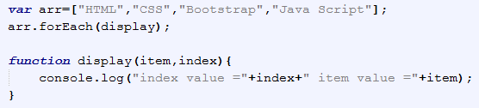
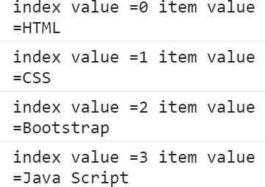
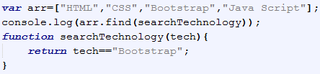

Array Methods cont…
forEach() : method calls a function once for each element in an array, in order. It is a better version of for loop.
The find() method executes the function once for each element present in the array:
If it finds an array element where the function returns a true value, find() returns the value of that array element (and does not check the remaining values) otherwise it returns undefined

Slide 28
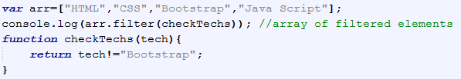
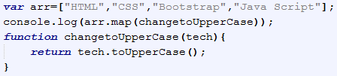
Array Methods cont…
The filter() method creates an array filled with all array elements that pass a test (provided as a function).
The map() method creates a new array with the results of calling a function for every array element. It calls the provided function once for each element in an array, in order.

Slide 29
String and String methods
JavaScript strings are used for storing and manipulating text. Below are various methods for string. Syntax:
var str=“company”;
Below are the list of methods supported in string :
Scenarios | Code | Output
Find the length of string | var str= “company”; str.length; | 7
Change to upper or lower case | str.toLowerCase(); str.toUpperCase(); | company COMPANY
To get a character at specified index | str.charAt[3]; str[3]; | p p
Trims whitespace from both sides of a string | str.trim(); | company
Finding a substring inside a string and extracting it | str.indexOf(“pan”); Str.slice(3,5); | 3 if not found then -1 pan

Slide 30
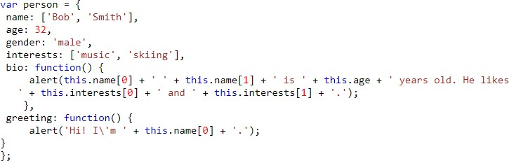

Object
An object is a collection of related data and/or functionality (which usually consists of several variables and functions — which are called properties and methods when they are inside objects.)
Declaration of object
Accessing the object properties

Slide 31
Hands on Array, String and Object
Create an array of Strings which contains the values like [“sTandarD”,”CharTered”,”banK”] then replace the array values with corresponding Uppercase values only.
[“STANDARD”,”CHARTERED”,”BANK”]

Slide 32
Module 5: Event and Event Handler
31

Slide 33
Events
Events are actions or occurrences that happen in the system you are programming, which the system tells you about so you can respond to them in some way if desired.
For example, if the user clicks a button on a webpage, you might want to respond to that action by displaying
an information box.
Below table consists types of events-
Mouse Events | Keyboard Events | Form Events | Document/Window Events
onclick | onkeypress | onsubmit | onload
ondblclick | onkeydown | onchange | onunload
onmouseenter | onkeyup | onfocus | onscroll
onmouseleave |  | onblur

Slide 34
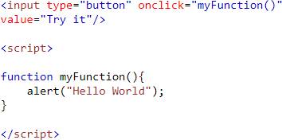
Event Handler
Each available event has an event handler, which is a block of code (usually a user-defined JavaScript function) that will be run when the event fires.
When such a block of code is defined to be run in response to an event firing, we say we
are registering an event handler. Event handlers
are sometimes called as event listeners

Slide 35
Module 6: DOM and Form Manipulation
34

Slide 36
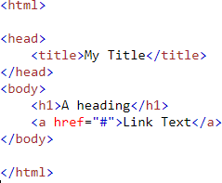
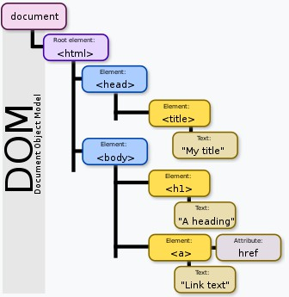
Document Object Model
The Document Object Model (DOM) is a cross-platform and language-independent application programming interface that treats an HTML document as a tree structure wherein each node is an object representing a part of the document. The DOM represents a document with a logical tree.

Slide 37





DOM Methods
document.getElementById() : returns an element with a given id attribute value.
document.getElementsByTagName() : returns an array containing all the elements on the page of a given type.
document.getElementsByClassName() : returns an array containing all the elements on the page of a given class.
document.querySelector() : returns the very first matching element as per the selector.
document.querySelectorAll() : returns the all matching elements as per the selector.

Slide 38
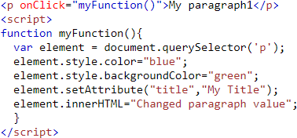
DOM Manipulation
In DOM manipulation, we can modify below fields on existing DOM tree:
Element CSS properties: ele.style.color=“blue”;
Element Attribute values:
ele.setAttribuite(“width”,”100px”);
Element values ele.innerHTML=“Updated value”;

Slide 39
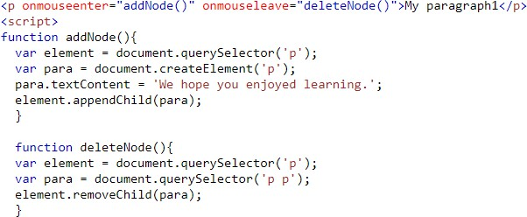
Creation or Deletion of nodes in DOM :
Let us learn how to create, add, replace or remove the node
Element creation:
Element addition in tree:
•
Element removal from tree:

Slide 40
Regular Expression Pattern and Quantifiers
Pattern | Description
[0-9] | Find any of the digits between the brackets
[A-Z] | Find any of the characters (capital letters) between the brackets
[0-9a-z] | Find any of the alphanumeric characters between the brackets
(x|y) | Find any of the alternatives separated with |
Quantifier | Description
[0-9]+ | Matches any string that contains at least one digit
[0-9]* | Matches any string that contains zero or more occurrences of n
[0-9]? | Matches any string that contains zero or one occurrences of n
[0-9]{3} | Matches any string that contains exactly 3 occurrences of n
[0,9]{3,6} | Matches any string that contains minimum 3 occurrences of n and max 6 occurrences
Example 1: To check name field can only have alphabets.
The pattern can be :
/^[A-Za-z]+$/ or
“^[A-Za-z]+$”
/^[a-z]+$/i (case insensitive)
Example 2: To check contact field can only have numbers of 10 digits.
The pattern can be :
/^[7-9]{1}[0-9]{9}$/ or
“^[7-9]{1}[0-9]{9}$”

Slide 41
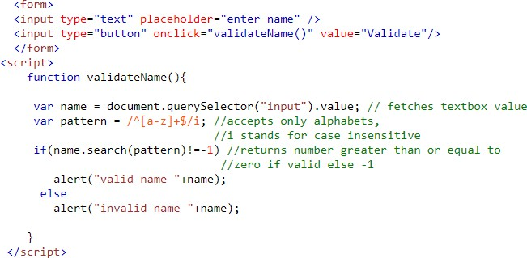
Form Validation
Fetch Form element values: Syntax: formelement.value
The search() method that tests for a match in a string. It returns the index of the match, or -1 if the search fails. Syntax: name.search(pattern)

Slide 42
DOM and Form validation Hands-on
Create an array of strings and display its values in list format in browser.
Take input from the name text box and validate to check if it contains only alphabets or not. If it does not
contain, display the error message next to the text box “please enter only alphabets”.

Slide 43
Module 7: Advanced JavaScript
Let and const keywords
Arrow functions
class and object
Destructuring
The Spread Operator
Promises
The Fetch API
Import and Export

Slide 44
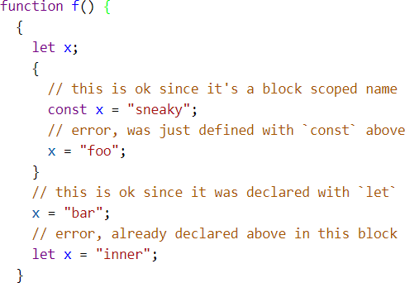
let and const keyword
Both are block scoped i.e. will be accessible only inside the block wherever they are declared.
let is the new var and const is single- assignment.
let declares a block-scoped, local variable, optionally initializing it to a value.
const declares a block-scoped, read-only
named constant.

Slide 45
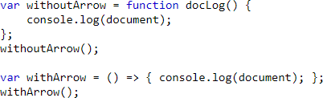
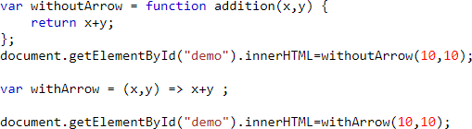
Arrow functions
Arrow functions were introduced as a new
syntax for writing JavaScript functions.
They save developers time and simplify function scope.
They use a token => that looks like a fat arrow
Syntax:
(param1,param2) => { //expression statements}

Slide 46
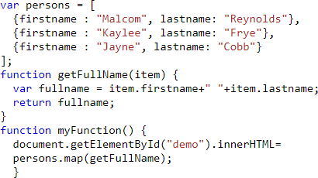
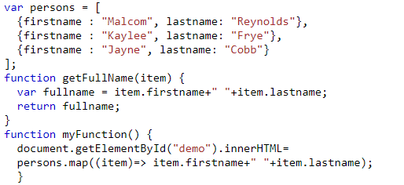
More Examples on Arrow Functions
Without Arrow Functions
With Arrow Functions

Slide 47
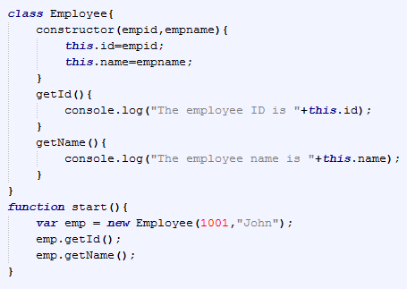
Class and Object
A class is a blueprint that contains the variables and the methods.
An object is an instance of class.
A class contains:
Field / Data members
Constructors
Member functions

Slide 48
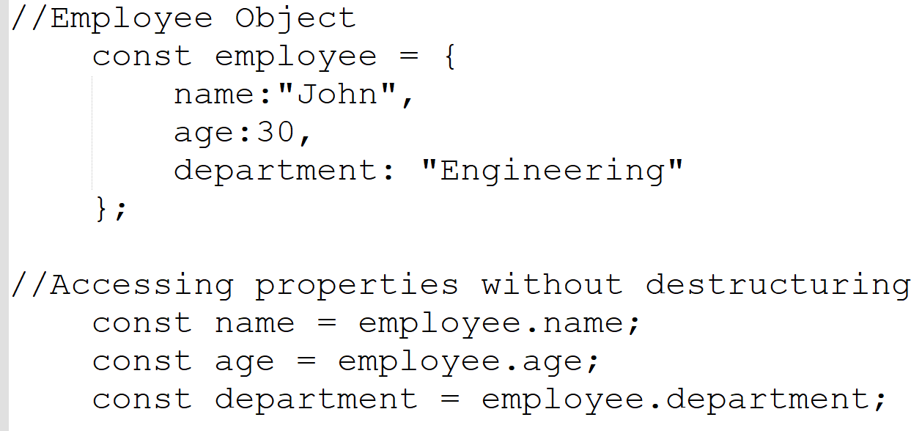
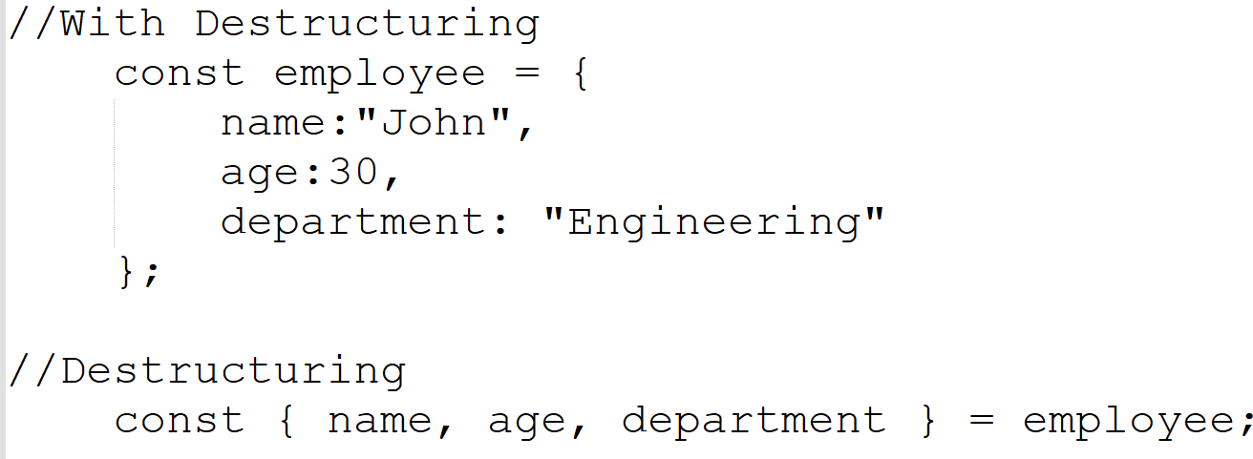
Destructuring
Destructuring helps to unpack values from arrays and objects.
Assigns them to separate variable.
Without Destructuring
With Destructuring

Slide 49
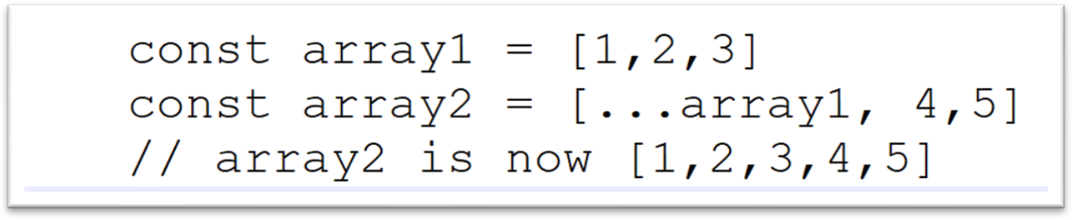
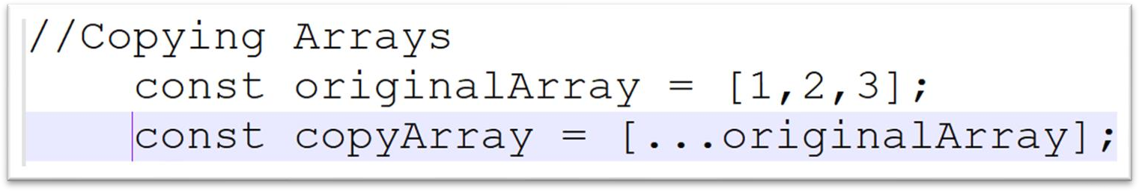
The Spread Operator
It takes an iterable and expands it into individual elements
The Spread operator is (‘…’)
Example 1
Example 2

Slide 50
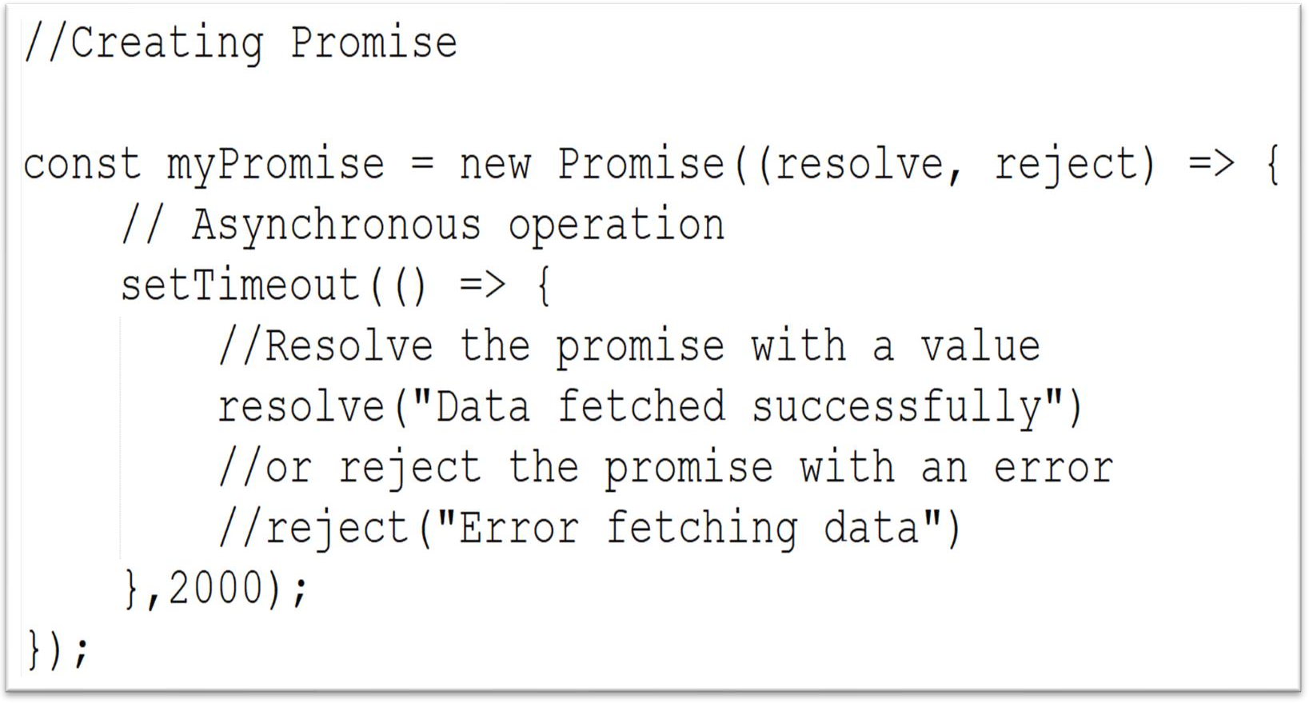
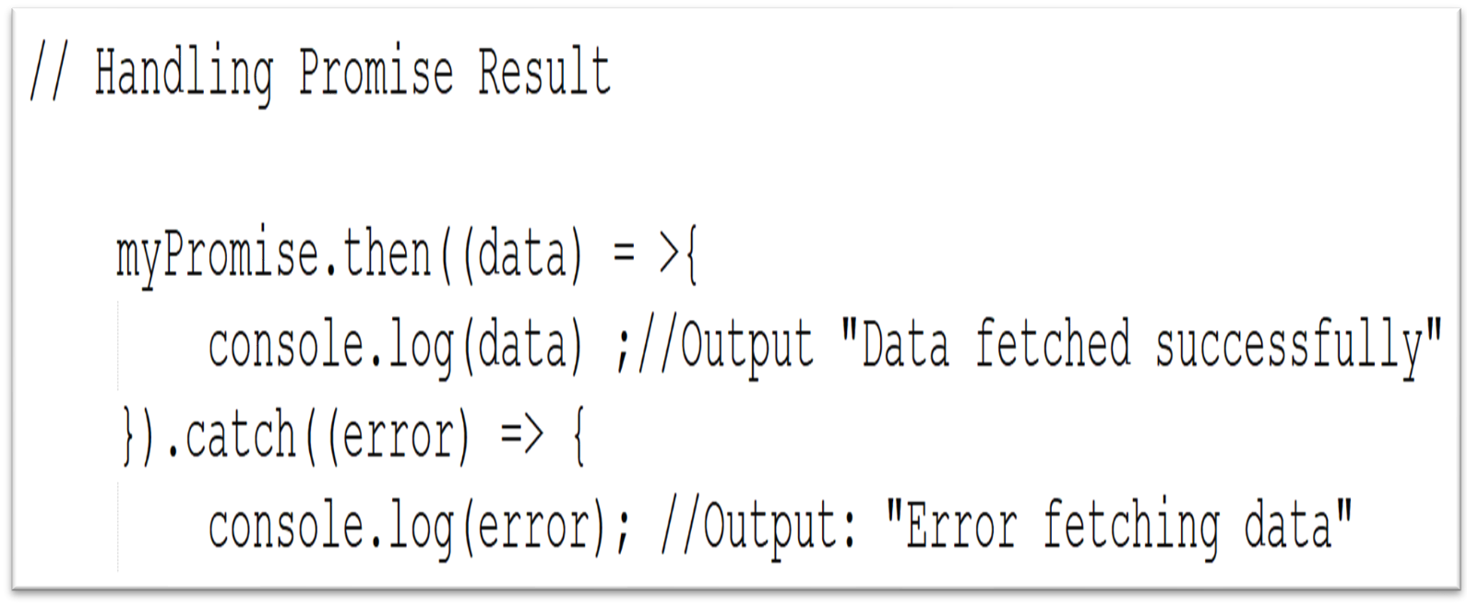
Promises
Promises in JavaScript are a way to handle asynchronous operations.
They represent a value which may be available now, or in the future, or never.
Promises are used to handle the results of asynchronous operations, such as fetching data from server, reading files.

Slide 51
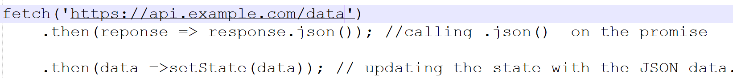
The Fetch API
The Fetch API is a modern interface for fetching resources(like JSON, HTML, or images) across the network. It provides a more powerful and flexible features set than the older XMLHttpRequest (XHR) method.
A basic fetch() takes one argument, the URL of the resource you want to fetch. It then returns another promise that resolves with a Response object.
This Response object is the representation of the HTTP response.
Example:

Slide 52
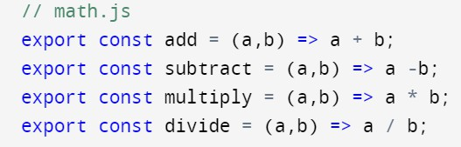
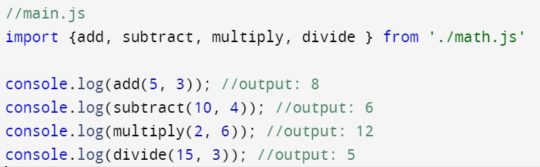
Import and Export
The export and import are the keywords used for exporting and importing one or more members in a module.
Suppose you have a file named ‘math.js’ which contains some math-related functions that you want to use
in another file.
Now, let’s say you have another file named ‘main.js’ where you want to use these functions:

Slide 53
Import and Export contd..
In the main.js file, we use the ‘import’ statement to bring in specific functionalites from the ‘math.js’ file. Then we can directly use those exported functions within the ‘main.js’ file.
‘export’ and ‘import’ can be used with various other syntaxes and configurations, such as default exports and named exports.

Slide 54
Async/await
Async/Await functionality provides a better and cleaner way to deal with promises.
JavaScript is synchronous in nature and async/await helps us write promise-based functions in such a way as of they were synchronous by stopping the execution of further code until the promise is resolved or rejected.

Slide 55
Use Case on Advanced JavaScript

Slide 56
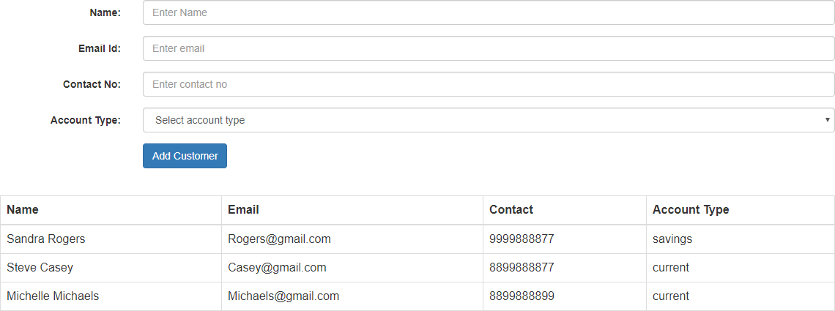
Use Case on Advanced JS

Slide 57
Description on Use Case
Create the page using Bootstrap. After entering the valid values, once user clicks on Add Customer button,
create the customer object and display in tabular format.
Validate the fields name (alphabets allowed), email id ( valid email id), contact no( only 10 digits and first digit should be 7-9) and account type should be selected.
Whenever user inserts invalid value, show the error message next to text box for ex please enter only alphabets

Slide 58
2. Presenting the Use Case
Add testimonial page to sc website by collecting the data from the user and add it to the testimonials dynamically with edit and delete Operation using JavaScript.

Slide 59

Presenting the Use Case
Submit
Name
Your Name
Message
Enter your Message
Testimonials
Ritu
Edit | Delete
It has been a positive experience with personable banking service in a timely manner

Slide 60
Cheat Sheet references
Cheat Sheet for JavaScript : JS Cheat Sheet.doc
Cheat Sheet for Advanced JS : Advanced JS Cheat Sheet

Slide 61

Thank You

